Slide 1
ADA1 and SCID Disease
Emanuel Perez

Slide 2
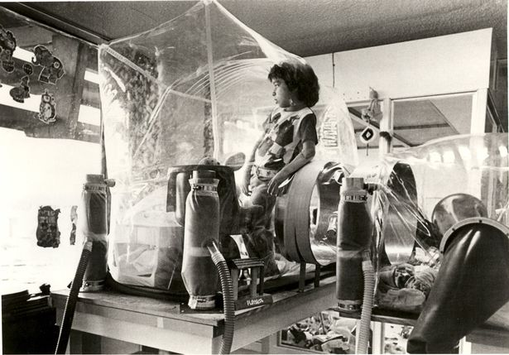
What are the symptoms of SCID?

Slide 3
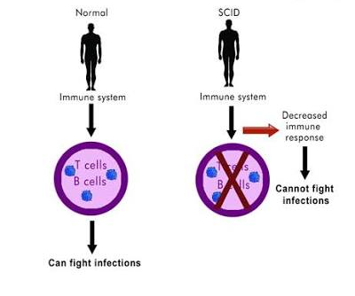
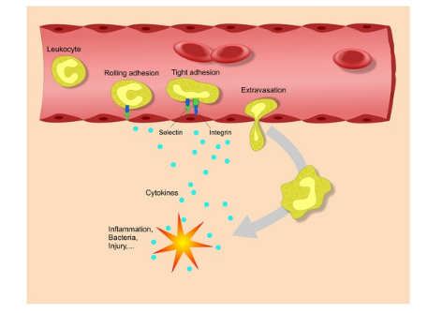
What are the symptoms of SCID?

Slide 4
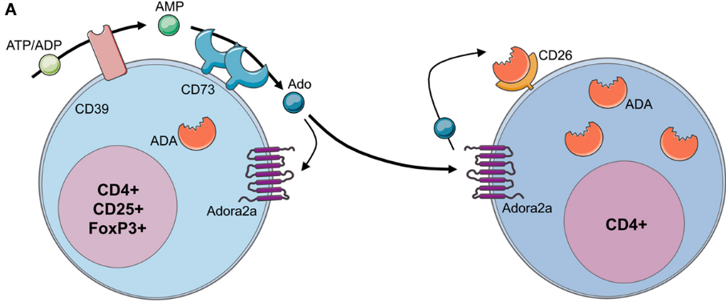
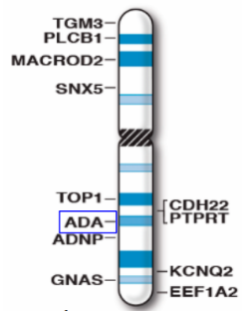
Where is ADA1 found?
Located majorily in T & B Cells
Chromosome 20

Slide 5
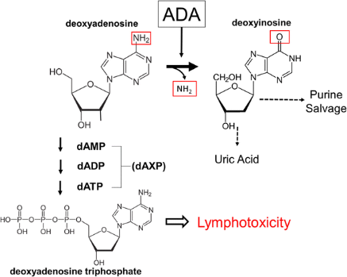
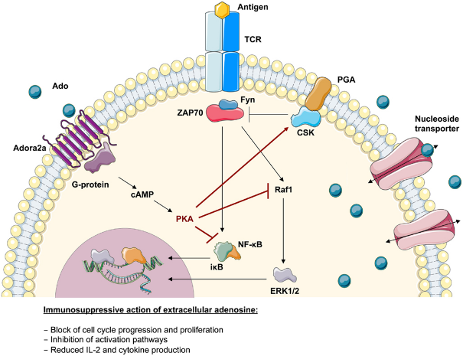
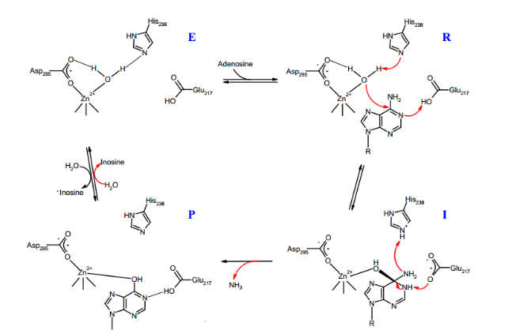
How does ADA1 Function and where is it found?
Mitochondria
Biological Process
Nucleus
Cytoplasm
Cellular Component
Molecular Function

Slide 6
Is ADA1 conserved among species?
Active Site
Humans
100%
Active Site
Mouse
98%
Active Site
Active Site
Zebrafish
69%
Active Site
Cow
89%
Zn Binding
Site
HTH _18
Mtransf
DBD1
E. coli
33%

Slide 7
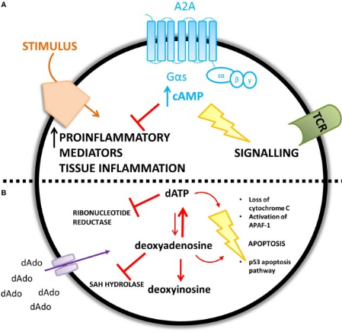
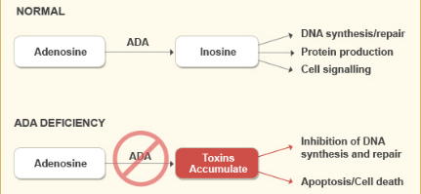
How do ADA mutations affect the Immune System?
Gene mutations leads to Adenosine build up
Accumulation of adenosine metabolites results in cell death

Slide 8
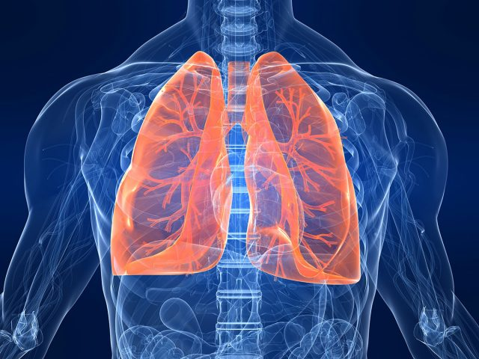
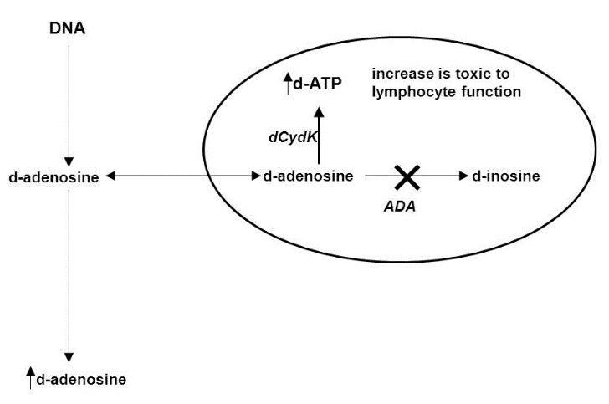
Current gap in knowledge?
?

Slide 9
What are adequate model organisms to study with?

Slide 10
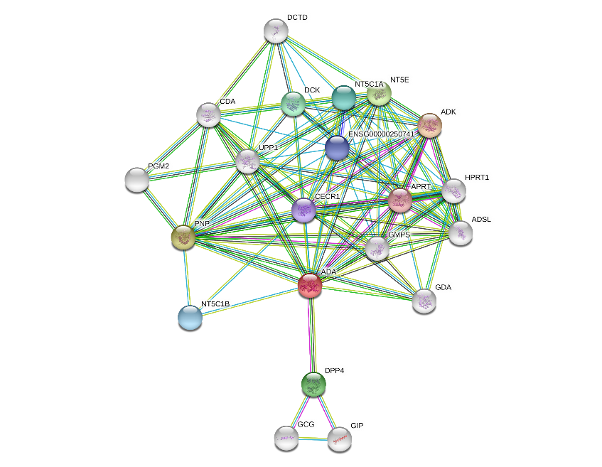
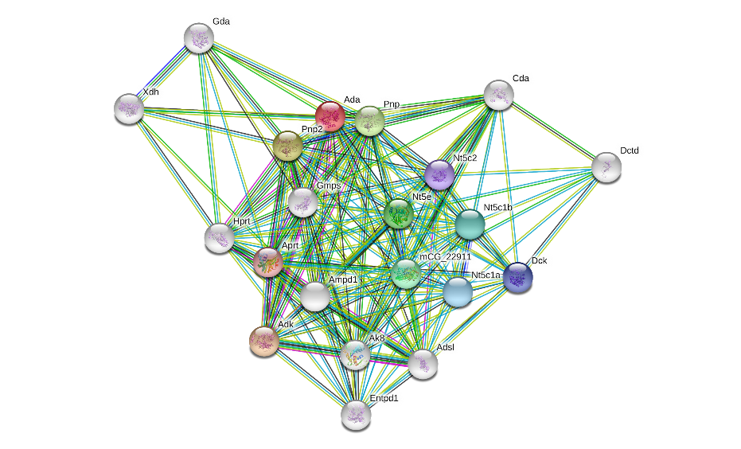
What do human and mice protein interactions compare?
Humans
Mice

Slide 11
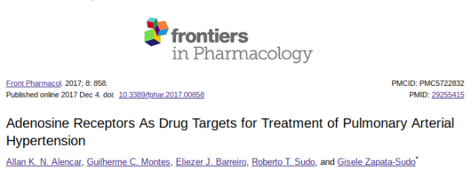
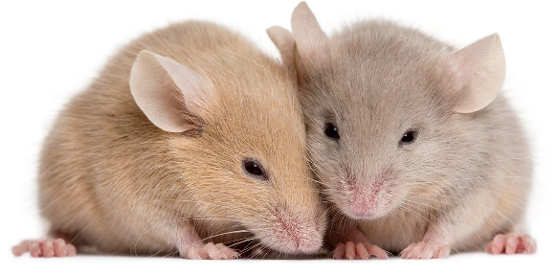
What is the primary goal?
To investigate and further understand how the ADA mutation is linked to pulmonary dysfunction

Slide 12
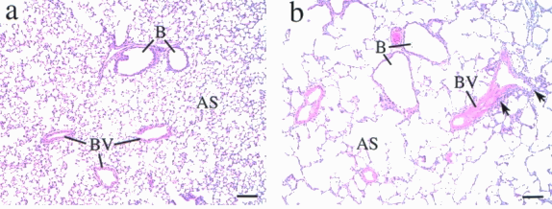
What is the mice mutant phenotype?
Wild-Type Mice ADA mutant mice

Slide 13
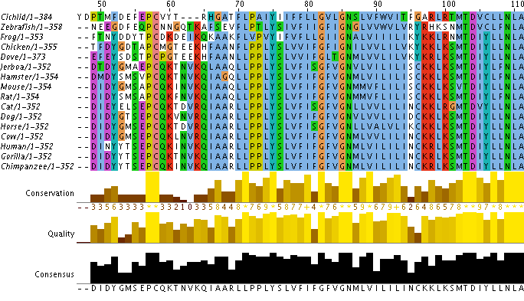
Aim 1: Determine conserved protein domain or amino acid sequences in ADA1 necessary for pulmonary airway function.

Slide 14
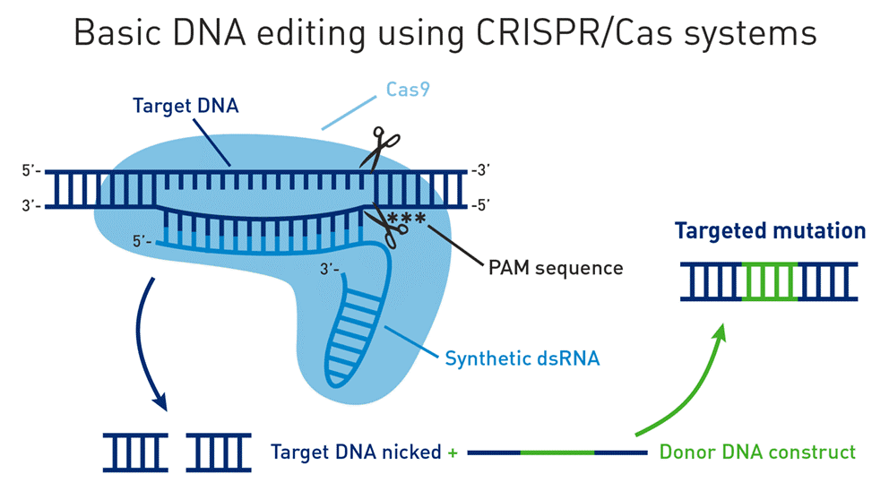
Aim 1: Determine conserved protein domain or amino acid sequences in ADA1 necessary for pulmonary airway function.

Slide 15
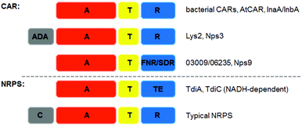
Aim 1: Determine conserved protein domain or amino acid sequences in ADA1 necessary for pulmonary airway function.

Slide 16
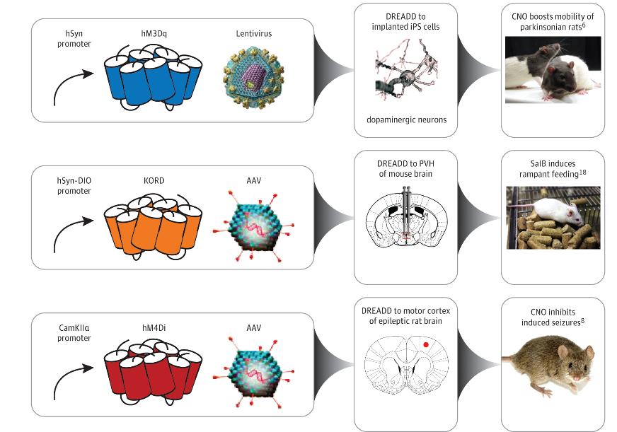
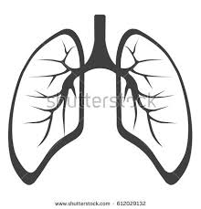
Aim 2: identify small molecules that rescue pulmonary defects observed in ADA1 mutant mice
I

Slide 17
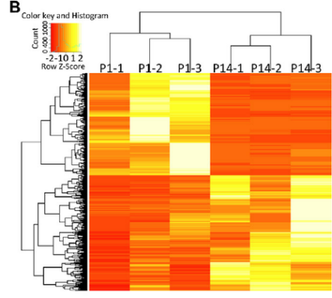
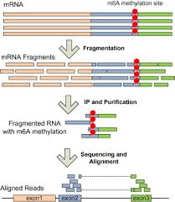
Aim 2: identify small molecules that rescue pulmonary defects observed in ADA1 mutant mice
I

Slide 18
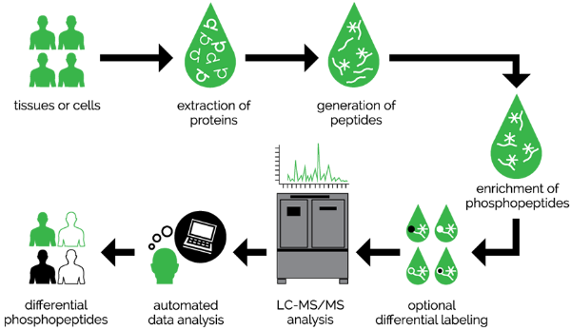
Aim 3: Identify novel protein interactions with adenosine receptors in lung cells important for lung function regulation.

Slide 19
Future Directions

Slide 20
Conclusions
ADA is involved heavily in the immune system as well as lung, and metabolisms development
ADA has been linked to pulmonary abnormalities post SCID treatment
Identifying novel targets in protein association with adenosine receptors is critical
to finding a specific approach to curing the dysfunction

