Slide 1
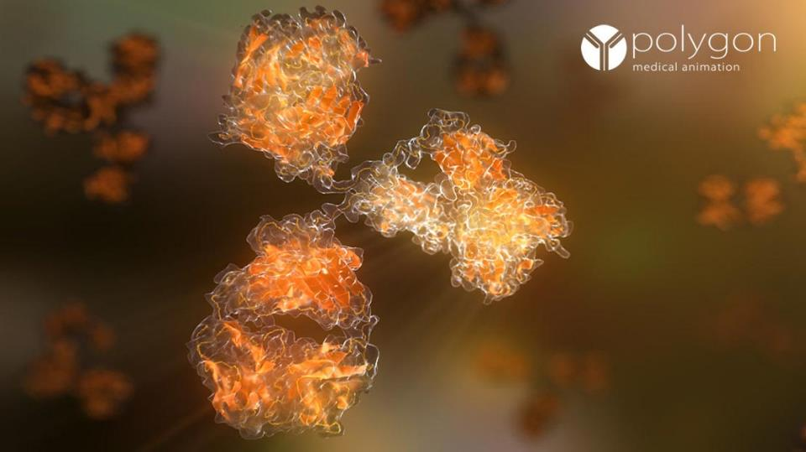
ADA1 and SCID disease
Severe Combined Immunodeficiency
with ADA1 linkage
Emanuel Perez

Slide 2
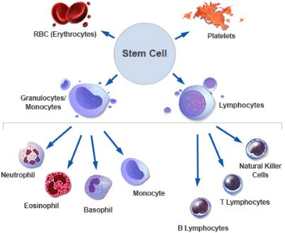
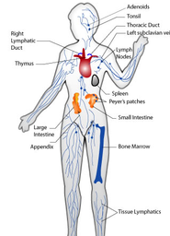
What is Severe Combined Immunodeficiency?
X
SCID rare immunological disorder affecting survival and function of T-, and/or B-, and NK lymphocytes. The virtual lack of T, B, and NK Cells renders these patients unable to fight pathogens.

Slide 3
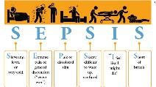
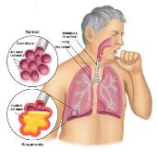
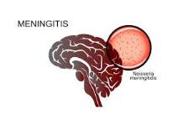
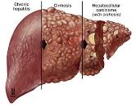
Symptoms of SCID
Meningitis
Pneumonia
Liver Infection

Slide 4
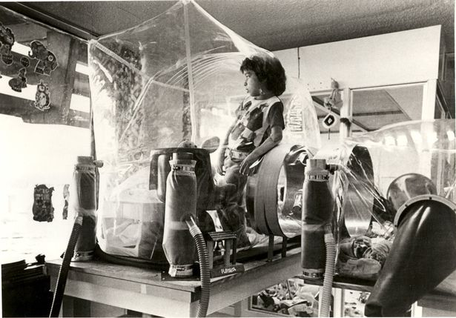
Symptoms of SCID

Slide 5
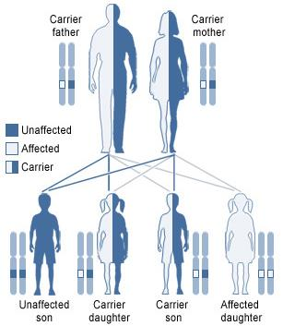
What is the genetic basis of SCID?
SCID is an autosomal recessive disease affecting 1 in 40,000 – 75,000 annually
North Americans of Navajo and Apache as well as middle eastern Turkish groups more prone

Slide 6
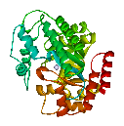
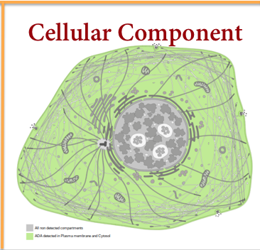
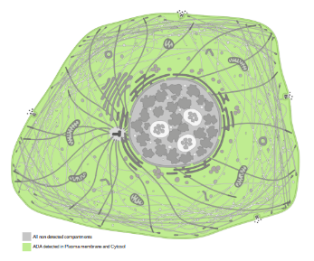
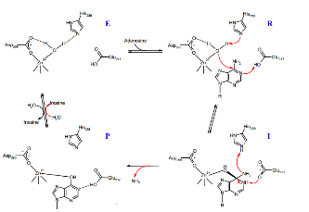
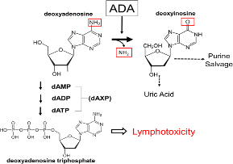
What gene is involved in SCID?
Active Site
Adenosine Deaminase
Molecular Function
Biological Process
Cellular Component

Slide 7
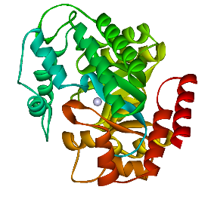
What gene is involved in SCID?
Active Site
Adenosine Deaminase
Molecular Function
Biological Process
Cellular Component
ADA-SCID occurs 1 in 200,000 to 1,000,000 newborns worldwide. Accounts for 15% of all SCID cases

Slide 8
What gene is involved in SCID?
Active Site
Adenosine Deaminase
Molecular Function
Biological Process
Cellular Component

Slide 9
What gene is involved in SCID?
Active Site
Adenosine Deaminase
Molecular Function
Biological Process
Cellular Component

Slide 10
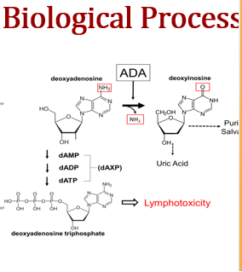
What gene is involved in SCID?
Active Site
Adenosine Deaminase
Molecular Function
Biological Process
Cellular Component

Slide 11
What gene is involved in SCID?
Active Site
Adenosine Deaminase
Molecular Function
Biological Process
Cellular Component

Slide 12
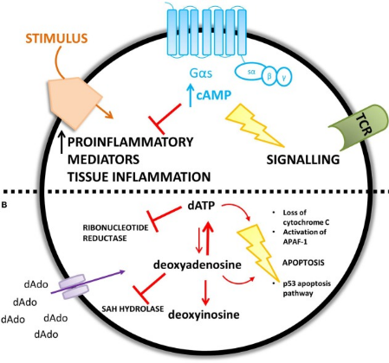
How do ADA mutations affect the Immune System?
A2A
dATP
v
X
Gene mutations leads to Adenosine build up. Accumulation of adenosine metabolites results in cell death

Slide 13
How conserved is ADA among model organisms?
Length
ID
Adenosine/AMP Deaminase
Adenosine/AMP Deaminase
363 aa
100%
Adenosine/AMP Deaminase
363 aa
99%
Adenosine/AMP Deaminase
Adenosine/AMP Deaminase
352 aa
98%
Adenosine/AMP Deaminase
337 aa
92%
Adenosine/AMP Deaminase
Adenosine/AMP Deaminase
362 aa
69%
AMP Deaminase
355 aa
29%
AMP Deaminase
Adenosine/AMP Deaminase
Adenosine/AMP Deaminase
357 aa
26%

Slide 14
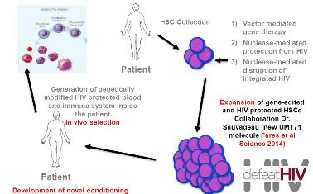
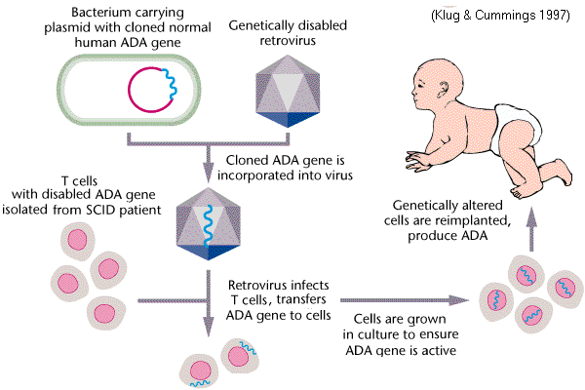
Treatments for ADA SCID
Enzyme Replacement Therapy
Bone Marrow/Stem Cell transplant

Slide 15
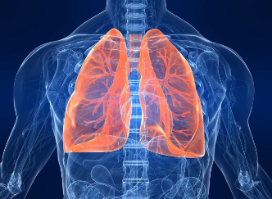
Current gap in knowledge?
?
Pulmonary alveolar proteinosis (PAP)

Slide 16
Choosing a model organism

Slide 17
What Model Organism to Choose?

Slide 18
What Model Organism to Choose?

Slide 19
What Model Organism to Choose?

Slide 20
What Model Organism to Choose?

Slide 21
What Model Organism to Choose?

Slide 22
What Model Organism to Choose?

Slide 23
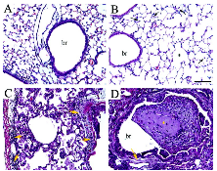
What Model Organism to Choose?

Slide 24
What Model Organism to Choose?

Slide 25
Pulmonary Inflammation in Mice
Top row showed 6 week old mice, bottom row 10 week old mice showing severe inflammation and airway damage

Slide 26
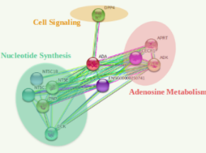
Protein Interaction Networks
Humans
Zebrafish
Mice
Cell Signaling
Cell Signaling

Slide 27
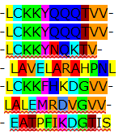
What is the primary goal?
Determine the role of ADA deficiency in pulmonary dysfunction
Aim 2
Aim 1
Aim 3
Use RNA-Seq on ADA1 knockout zebrafish to identify differentially expressed transcripts important for gill function
Determine conserved amino acid sequences in ADA1 necessary for pulmonary function
Identify protein interactors with ADA1 mutants vs WT
Humans
WT
ADA+/ADA-
ADA-/ADA-
Gibbon
Mice
Fruit fly
Zebrafish
Thale Cress
Yeast
Proton Donor Active Site
Hypothesis: Accumulated levels of adenosine increases cell signaling pathways responsible for hyper-constriction of the lungs and increased inflammation

Slide 28
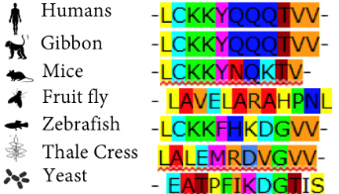
Aim 1: Determine conserved protein domain or amino acid sequences in ADA1 necessary for pulmonary airway function.
Proton Donor Active Site
Hypothesis: The zebrafish ada mutants will show gill inflammation due to the increased levels of adenosine

Slide 29
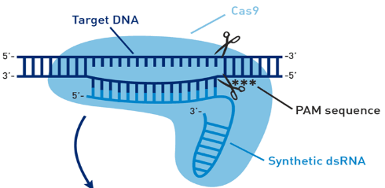
Aim 1: Determine conserved protein domain or amino acid sequences in ADA1 necessary for pulmonary airway function.
WT
ADA+/ADA-
ADA-/ADA-

Slide 30
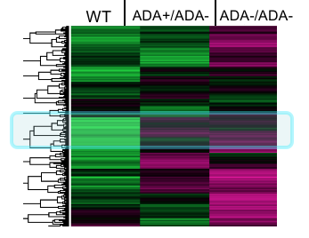
Aim 2: Use RNA-Seq on ADA1 knockout zebrafish to identify differentially expressed transcripts
I
Regulation of inflammation
Gill function genes
Hypothesis: I expect to see pulmonary irregularities in the knockout mice that with aa missense mutations from aims 1

Slide 31
Aim 2:Use RNA-Seq on ADA1 knockout zebrafish to identify differentially expressed transcripts

Slide 32
Aim 2:Use RNA-Seq on ADA1 knockout zebrafish to identify differentially expressed transcripts

Slide 33
Aim 3: Identify novel protein interactions with ADA1 mutants
Hypothesis: The analysis of differential expression of proteins found in the ADA deficient mice will find genes that are directly related to lung function regulation

Slide 34
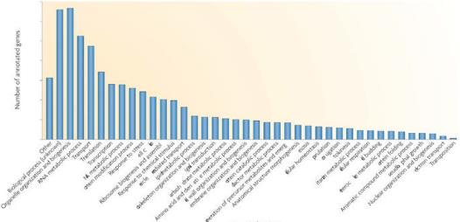
Aim 3: Identify novel protein interactions with ADA1 mutants

Slide 35
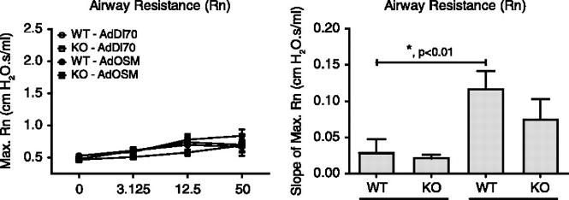
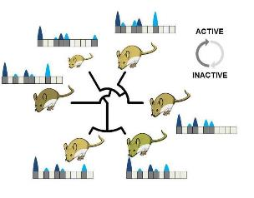
Aim 3: Identify novel protein interactions with ADA1 mutants
ADA1 +/+
ADA1 +/-
ADA1 +/+
ADA1 -/-

Slide 36
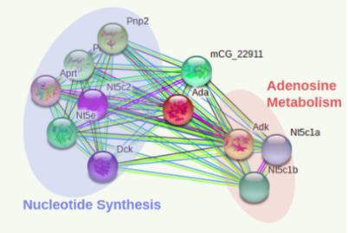
Aim 3: Identify novel protein interactions with ADA1 mutants
Wild Type Mice
ADA1 Deficient Mice

Slide 37
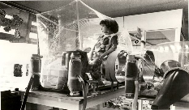
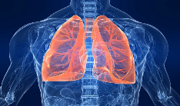
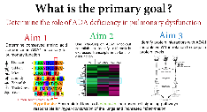
Summary
SCID is an immunological disorder disturbing normal development of the immune system & antibody responses
ADA1 is a major player in SCID by disrupting the adenosine metabolism and has been linked to pulmonary airway disfunction still apparent after SCID treatment
Identifying conserved ADA1 regions vital to lung development and identifying the gene/ protein network affecting the normal function of the pulmonary system will close the gap in this unknown link between the ADA1 gene

Slide 38
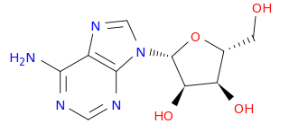
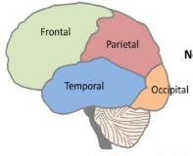
Future Directions
Mechanism of pathology not well studied in neurological defects attributed to dATP buildup
Optimal gene therapy studies continue as more countries allow advancement of genetic research

Slide 39
References
Text References
1) SCID http://www.stlouischildrens.org/diseases-conditions/severe-combined-immunodeficiency-scid
2) PROSITE https://prosite.expasy.org/cgi-bin/prosite/ScanView.cgi?scanfile=403201734109.scan.gz
3) Mechanism of ADA https://www.bocsci.com/blog/index.php/mechanism-of-reaction-of-adenosine-deaminase/
4) Adenosine Deaminase (ADA)-Deficient Severe Combined Immune Deficiency (SCID): Molecular Pathogenesis and Clinical Manifestations
https://www.semanticscholar.org/author/Kathryn-L.-Bradford/5338839
5) http://pfam.xfam.org/search/sequence
6) https://www.uniprot.org/uniprot
7) Adenosine Deaminase Deficiency – More Than Just an Immunodeficiency.
https://www.ncbi.nlm.nih.gov/pmc/articles/PMC4985714/
Image References
1) What causes ADA-SCID? http://www.adagen.com/what_causes_ADA-SCID.html
2) Severe Combined Immunodeficiency Disorder https://geneticmutationsperiod6.wikispaces.com/Severe+combined+immunodeficiency+(SCID)
3) Monoclonal Antibody https://www.polygonmedical.com/monoclonal
4) Biochemistry Media Lab Clipart https://biochem.wisc.edu/medialab/clip-art-media-lab
5) The boy who lived in a buble http://www.dailymail.co.uk/news/article-3619420/Incredible-photos-Texan-boy-lived-12-years-bubble-desperate-hope-scientists-cure-auto-immune-disease.html
6) Meningitis https://www.healthmagaz.com/disorders/meningitis/meningitis-symptoms-causes-risks-complications-diagnosis-treatment-prevention/
7) Pneumonia http://treatment-zone.blogspot.com/2011/11/aspiration-pneumonia.html
8) Liver Disease https://www.pinterest.com/pin/476326098061050948/
9) ADA https://en.wikipedia.org/wiki/Adenosine_deaminase
10) https://speakingofresearch.com/facts/the-animal-model/
11) https://www.researchgate.net/figure/Nonlymphoid-phenotypes-associated-with-ADA-deficiency-in-mice-Lung-tissues-from-control_fig6_13752136
12) https://www.datasci.com/products/buxco-respiratory-products/finepointe-resistance-and-compliance
13) http://www.mdpi.com/1422-0067/18/4/817
14) http://www.clker.com/clipart-money-sign.html

Slide 40
References(Cont)
Text References
8) SCID Frequency http://www.babysfirsttest.org/newborn-screening/conditions/severe-combined-immunodeficiency-scid
9) The genetic basis of severe combined immunodeficiency and its variants
https://www.ncbi.nlm.nih.gov/pmc/articles/PMC3681194/Appl Clin Genet. 2012; 5: 67–80.Published online 2012 Aug 10. doi: 10.2147/TACG.S18693
Image References
11) Adenosine-dependent airway inflammation and hyperresponsiveness in partially adenosine deaminase-deficient mice.
Chunn JL¹, Young HW, Banerjee SK, Colasurdo GN, Blackburn MR.
12)Impulse oscillometry identifies peripheral airway dysfunction in children with adenosine deaminase deficiency Hirsh D. Komarow1*† , Robert Sokolic2† , Michael S. Hershfield3 , Donald B. Kohn4 , Michael Young5 , Dean D. Metcalfe1† and Fabio Candotti2,6†
Image References
15) http://www.arkadiapest.com/mice-control
16) https://link.springer.com/protocol/10.1007/978-1-61779-166-6_25
17) https://en.wikipedia.org/wiki/MEGA,_Molecular_Evolutionary_Genetics_Analysis
18) https://www.researchgate.net/figure/Pulmonary-function-tests-of-mutant-mice-with-reduced-bioavailable-VEGF-indicate-a_fig4_293825596
19) http://embomolmed.embopress.org/content/4/2/75

